Slide 1
STANDARD INPUT / OUTPUT

Slide 2
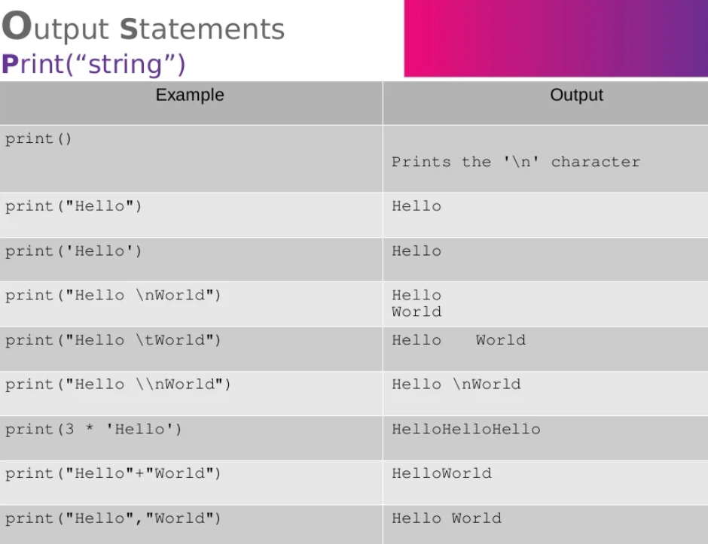

Slide 3
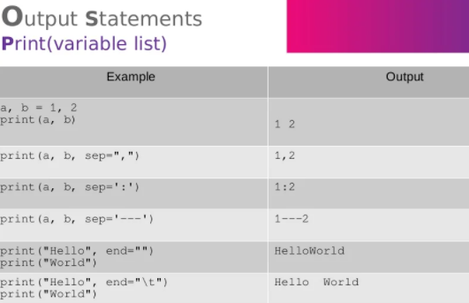


Slide 4
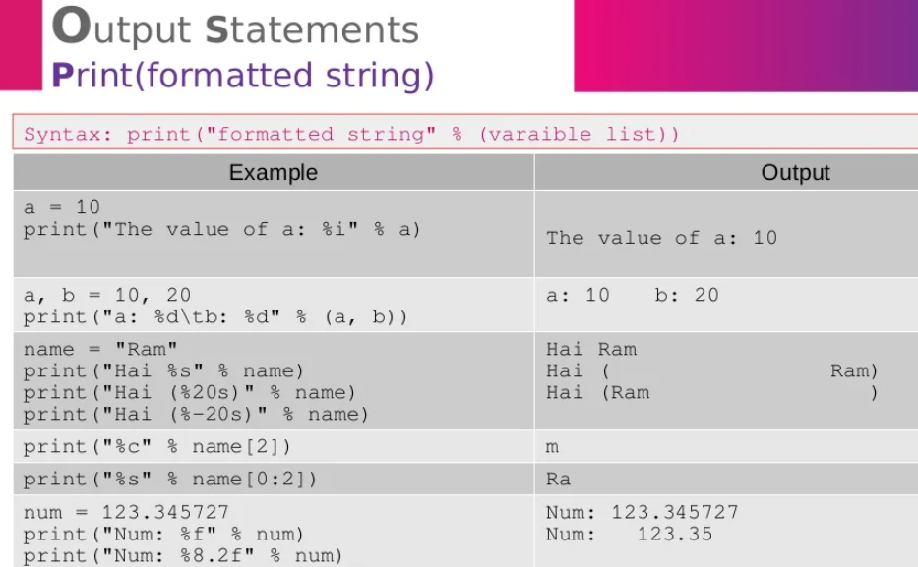

Slide 5
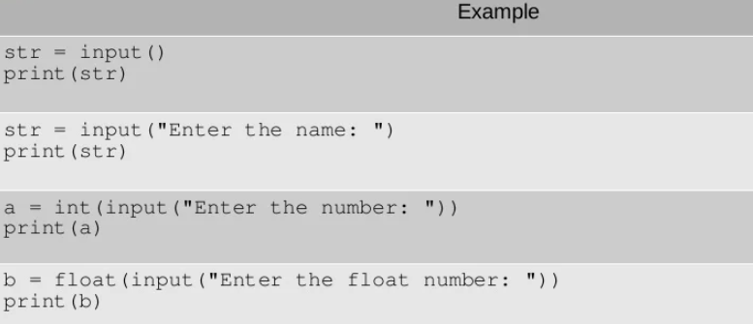
INPUT STATEMENTS
INPUT()

